Slide 1
CompTIA A+ Guide to IT Technical Support
10th Edition

Slide 2
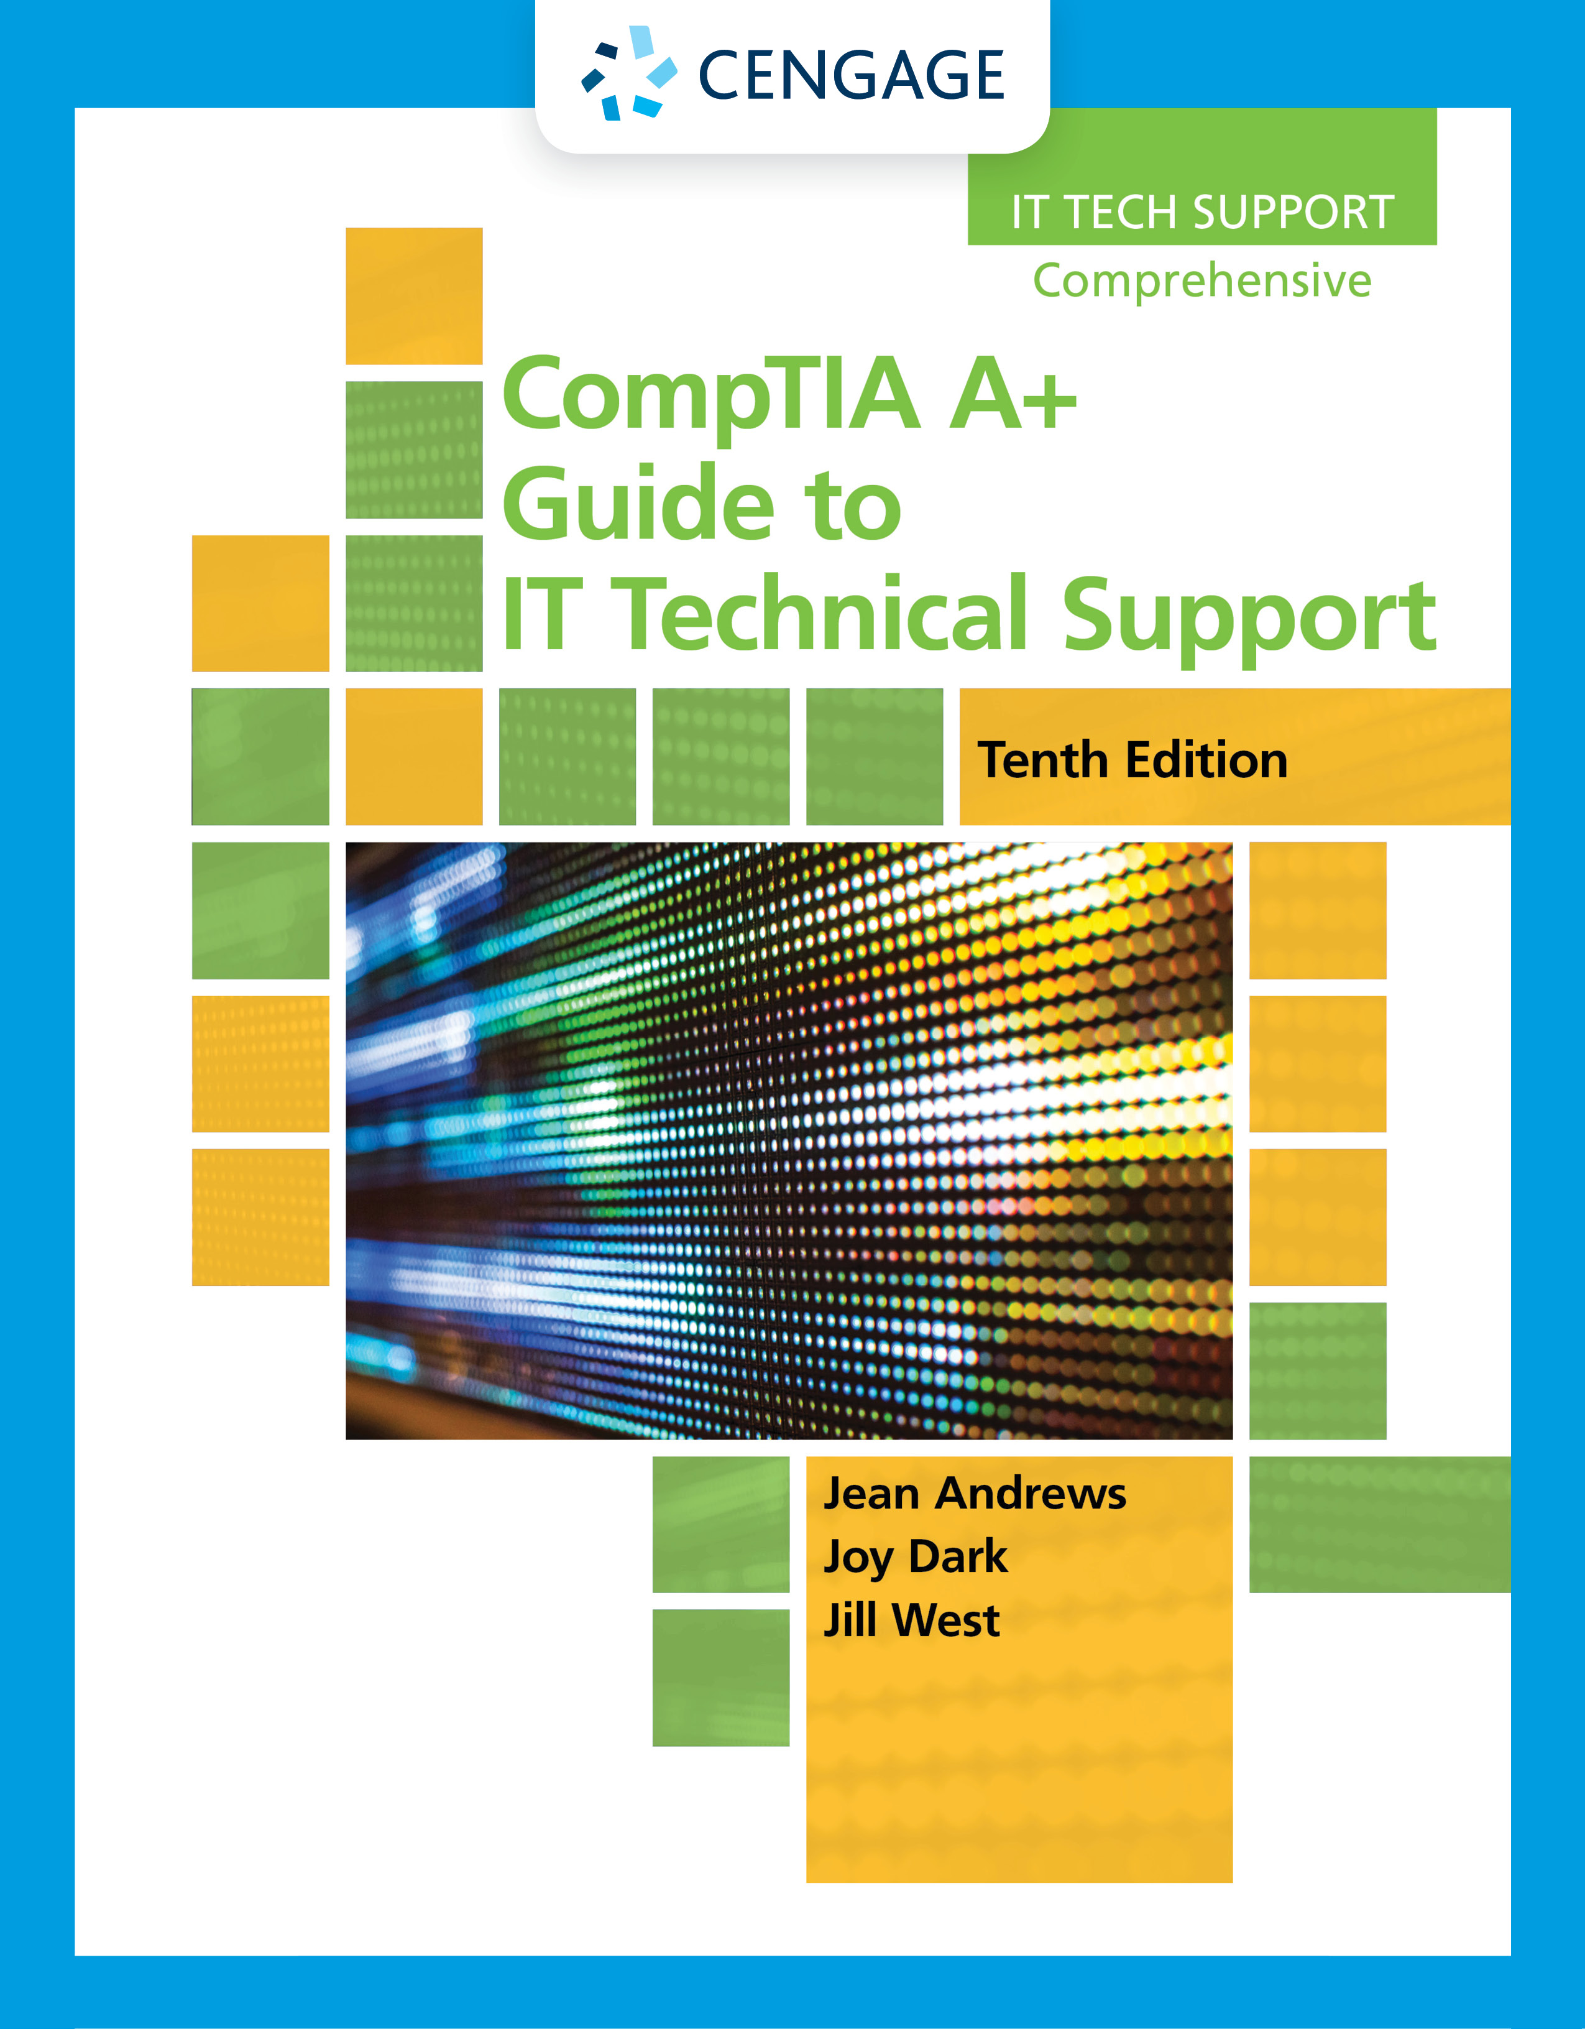
Supporting Processors and Upgrading Memory
Chapter 3

Slide 3
Objectives
Compare characteristics and features of Intel and AMD processors used for personal computers
Select, install, and upgrade a processor
Compare the different kinds of physical memory and how they work
Upgrade memory

Slide 4
Types and Characteristics of Processors (1 of 3)
Processor
Installed on motherboard and determines system computing power
Two major processor manufacturers
Intel and AMD
Features affecting processor performance and compatibility with motherboards
Processor speed
Lithography
Socket and chipset the processor can use
Multiprocessing abilities
Multiprocessing
Multithreading
Multicore processing
Dual processors

Slide 5
Types and Characteristics of Processors (2 of 3)
Features affecting processor performance and compatibility with motherboards (continued)
Memory cache
Memory features on the motherboard that the processor can support
Support for virtualization
Integrated graphics
Overclocking
Today’s processor architectures fall into two categories
Hybrid processors – known as x86-64 processors
Can handle a 32-bit OS or a 64-bit OS
64-bit processors – known as x64 processors or IA64
Require a 64-bit OS and can handle 32-bit applications only by simulating 32-bit processing

Slide 6
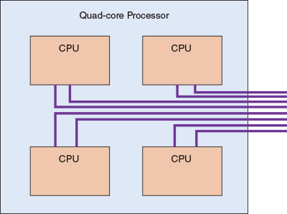
Types and Characteristics of Processors (3 of 3)
Figure 3-2 This quad-core processor has four cores and each core can handle two threads

Slide 7
Intel Processors (1 of 2)
Current families of processors for desktops and laptops include:
Intel Core processors
Core i9 and Core i7 are made for high-end desktops and laptops
Core i5 is well suited for mainstream desktops and laptops
Core i3 is an entry-level processor for desktops and laptops
Pentium processors
Designed for entry-level desktops and laptops
Atom processors
Made for low-end desktops, notebooks, and laptops
Celeron processors
Made for low-end netbooks and laptops

Slide 8
Intel Processors (2 of 2)
Some Intel mobile processors are packaged in the Centrino processor technology
The Intel processor, chipset, and wireless network adapter are all interconnected as a unit
Intel dominates the market for servers with highly stable and powerful processors
Models of the Core i9, Core i7, Core i5, and Core i3 processors are designed for server use
For high-end servers, Intel offers the Xeon, Xeon Phi, and Itanium processors

Slide 9
AMD Processors (1 of 2)
Processors by AMD are popular in the game and hobbyist markets
They are generally less expensive than comparable Intel processors
Current AMD processor families include:
For desktops, the Ryzen, Ryzen Pro, Ryzen Threadripper, A-Series, A-Series Pro, and FX
For laptops, the Ryzen, Ryzen Pro, A-Series, and A-Series Pro
For servers, the EPYC and Opteron

Slide 10
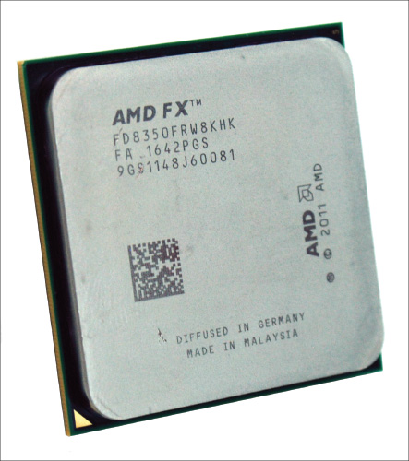
AMD Processors (2 of 2)
Figure 3-6 The AMD FX processor installs in the AMD AM3+ socket and has eight cores

Slide 11
Selecting and Installing a Processor
A hardware technician is sometimes called on to:
Assemble a computer from parts
Exchange a faulty processor
Add a processor
Upgrade an existing processor
In each situation, it is necessary to know how to:
Match a processor to the system
Install a processor on the motherboard

Slide 12
Selecting a Processor to Match System Needs (1 of 2)
First requirement:
Select a processor that the motherboard is designed to support
Next:
Select the best processor meeting general system requirements and user needs
Processor features to consider:
Use the highest-performing processor the board supports
Understand the processor’s ability to multitask
Balance the performance and power of the CPU with that of the entire system
Read reviews of the processors you are considering and look for reviews that include comparison benchmarks of several processors
When processors and coolers are boxed together, the cooler heat sink might have thermal compound already applied to the bottom

Slide 13
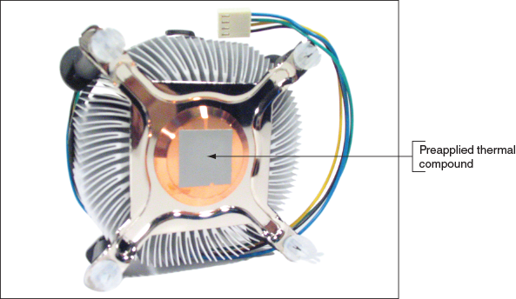
Selecting a Processor to Match System Needs (2 of 2)
Figure 3-7 Thermal compound is already applied to the bottom of this cooler that was purchased boxed with the processor

Slide 14
Installing a Processor and Cooler Assembly (1 of 14)
Always read motherboard user guide and follow directions
General procedure for installing an Intel processor:
1. Use an ESD strap or antistatic gloves
2. When replacing a processor, power down the system, unplug the power cord, press the power button to drain the system of power, and open case
3. Remove the socket protective cover
4. Open the socket by pushing down on socket lever and gently push away from socket to lift lever
5. As you lift the lever, the socket load plate is raised
6. Remove protective cover from processor
7. Hold processor with index finger and thumb and align processor so the two notches on the edge of the processor line up with the posts embedded on the socket

Slide 15
Installing a Processor and Cooler Assembly (2 of 14)
General procedure for installing an Intel processor (continued):
8. Ensure the processor is aligned correctly in socket
9. Push down on the lever and gently return it to its locked position

Slide 16
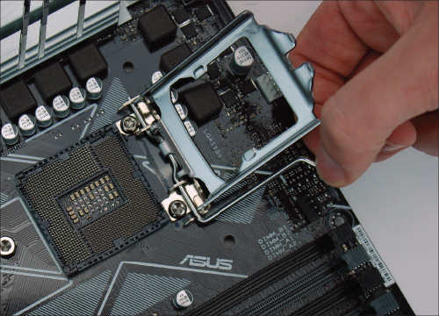
Installing a Processor and Cooler Assembly (3 of 14)
Figure 3-10 Lift the socket load plate to expose the processor socket

Slide 17
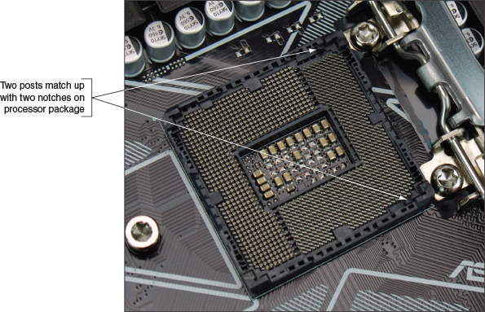
Installing a Processor and Cooler Assembly (4 of 14)
Figure 3-12 Align the processor in the socket using the gold triangle and the right-angle mark

Slide 18
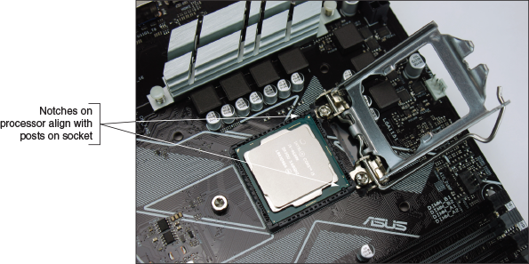
Installing a Processor and Cooler Assembly (5 of 14)
Figure 3-13 Verify the processor is seated in the socket with notches aligned to socket posts

Slide 19
Installing a Processor and Cooler Assembly (6 of 14)
General steps to install a cooler assembly:
1. Understand how cooler posts work
2. Apply thermal compound if necessary (may be preapplied)
3. Some heavy coolers provide a plate that fits underneath the motherboard
Install plate, if provided
4. After plate is installed, install the cooler on top of the processor
5. For lighter coolers with locking pins, verify locking pins are turned counter-clockwise as far as they will go
Push down on each locking pin until it pops into the hole
6. Connect power cord from cooler fan to motherboard
Check BIOS/UEFI setup to verify the system recognized processor after system up and running

Slide 20
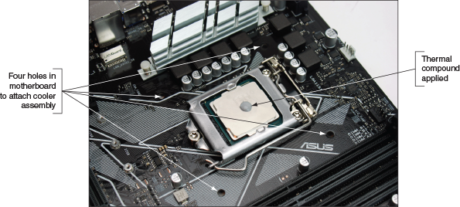
Installing a Processor and Cooler Assembly (7 of 14)
Figure 3-15 If the cooler does not have preapplied thermal compound, apply it on top of the processor

Slide 21
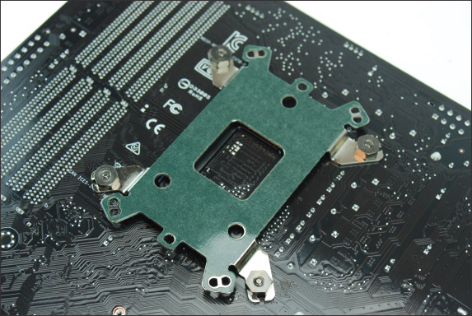
Installing a Processor and Cooler Assembly (8 of 14)
Figure 3-16 A cooler assembly plate on the bottom of the motherboard prevents a heavy cooler from bending the board

Slide 22
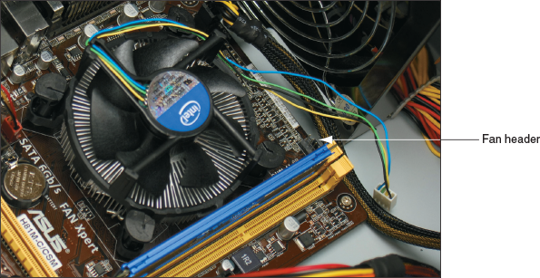
Installing a Processor and Cooler Assembly (9 of 14)
Figure 3-18 The pins are turned clockwise to secure the cooler to the motherboard

Slide 23
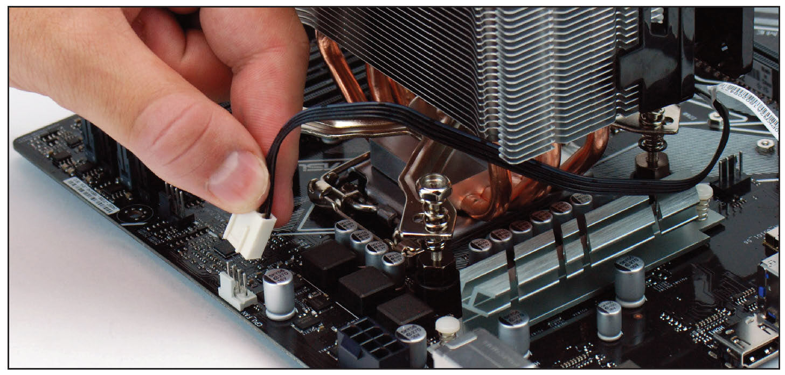
Installing a Processor and Cooler Assembly (10 of 14)
Figure 3-19 Connect the cooler fan power cord to the motherboard 4-pin CPU fan header

Slide 24
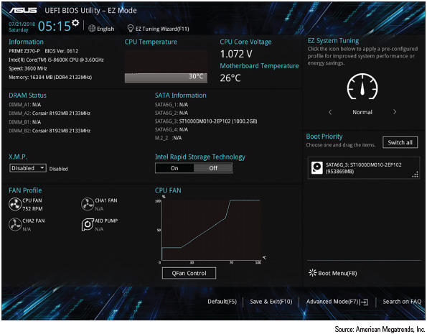
Installing a Processor and Cooler Assembly (11 of 14)
Figure 3-20 Verify that the CPU is recognized correctly by BIOS/UEFI and that CPU and motherboard temperatures are within acceptable range

Slide 25
Installing a Processor and Cooler Assembly (12 of 14)
Installing an AMD processor:
1. Open the socket lever and remove protective cover
2. Orient the four empty pin positions on the bottom with the four filled hole positions in the socket and carefully place processor in the socket
3. Verify processor pins are sitting slightly into the holes
4. Press the lever down and gently into position
5. Apply thermal compound and install cooler
6. Clip into place the clipping mechanism on one side of the cooler
7. Connect fan power cord to power connection

Slide 26
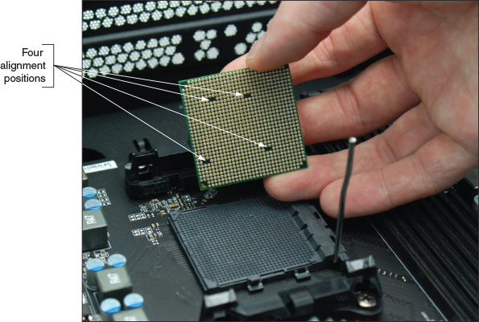
Installing a Processor and Cooler Assembly (13 of 14)
Figure 3-21 Orient the four alignment positions on the bottom of the processor with those in the socket

Slide 27
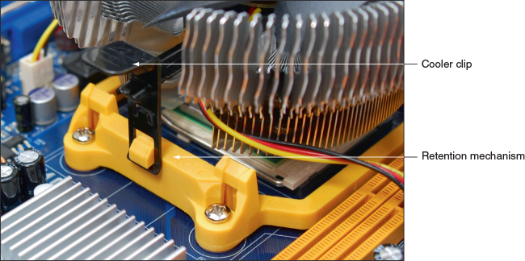
Installing a Processor and Cooler Assembly (14 of 14)
Figure 3-24 The clips on the cooler attach the cooler to the retention mechanism on the motherboard

Slide 28
Replacing the Processor in a Laptop (1 of 4)
Before replacing, consider the laptop might still be under warranty or it might be more cost effective to replace the laptop rather than replacing processor
If you decide to replace:
Use a CPU supported by manufacturer and notebook model
For some laptops, remove the cover on the bottom to expose the processor fan and heat sink assembly
Remove the seven screws and the fan power connector
Lift the CPU straight up from the socket, without bending the CPU pins
Before placing the new processor into the socket:
Be sure the socket screw is in the open position
Place the processor into its socket
Use thermal compound on top of the processor

Slide 29
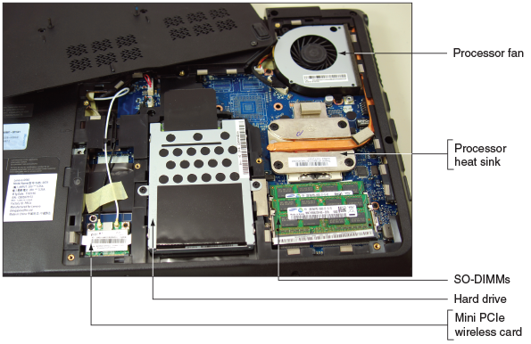
Replacing the Processor in a Laptop (2 of 4)
Figure 3-25 The cover is removed from the bottom of a laptop, exposing several internal components

Slide 30
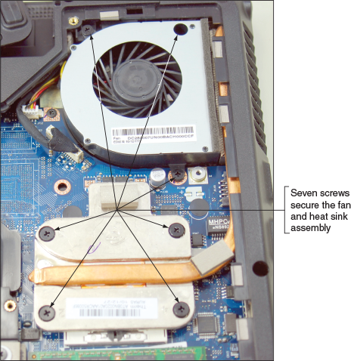
Replacing the Processor in a Laptop (3 of 4)
Figure 3-26 Seven screws hold the processor heat sink and fan assembly in place

Slide 31
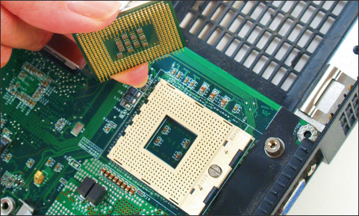
Replacing the Processor in a Laptop (4 of 4)
Figure 3-29 The processor removed from the socket

Slide 32
Memory Technologies (1 of 2)
Random access memory (RAM):
Temporarily holds data and instructions used by CPU
Dynamic RAM (DRAM):
Loses its data rapidly, and the memory controller must refresh it several thousand times a second
Variations of DRAM
DIMM – dual inline memory module
Used by desktops
SO-DIMM (small outline DIMM) are used on laptops and microDIMMs are used on subnotebook computers

Slide 33
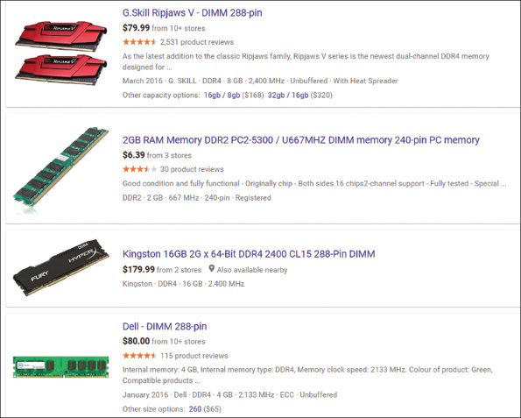
Memory Technologies (2 of 2)
Figure 3-31 Evolving memory technologies result in many details and options

Slide 34
DIMM and SO-DIMM Technologies (1 of 15)
The “D” in DIMM stands for “dual”
Named for the independent pins on both sides of the module’s edge connector
All DIMMs have a 64-bit data path
SIMM (single inline memory module) is an older technology that has pins on only one side
DDR (Double Data Rate) DIMM
Twice as fast as earlier DIMMs when it was invented
DDR2 SDRAM
Faster than DDR and uses less power
DDR3 SDRAM
Faster than DDR2 and uses less power
DDR2 and DDR3 use 240 pins
Not compatible: use different notches
DDR4 is faster and uses less power than DDR3
Uses 288 pins and has a single notch in the edge connector

Slide 35
DIMM and SO-DIMM Technologies (2 of 15)
Factors that affect capacity, features, and performance of DIMMS:
Number of channels they use
How much RAM is on one DIMM
Speed
Error-checking abilities
Buffering

Slide 36
DIMM and SO-DIMM Technologies (3 of 15)
Single, Dual, Triple, and Quad Channels
Early single channel DIMMs:
Memory controller is accessed one DIMM at a time
Dual channels:
Memory controller communicates with two DIMMs at the same time and doubles speed of memory access
Triple channel motherboards can access three DIMMs at once
Quad channel motherboards can access four DIMMs at the same time
DDR, DDR2, DDR3, and DDR4 DIMMs use dual channels
DDR3 DIMMs can also use triple channels
DDR3 and DDR4 can use quad channels

Slide 37
DIMM and SO-DIMM Technologies (4 of 15)
For dual, triple, or quad channels to work:
The motherboard and the DIMM must support the technology
Motherboard manufacturer typically color-codes DIMM slots to show you how to configure dual, triple, or quad channeling
Setting up dual channeling:
Pair of DIMMs in a channel must be equally matched in size, speed, and features
Use same manufacturer (recommendation)
Setting up triple-channeling:
Three DIMM slots populated with three matching DDR3 DIMMs

Slide 38
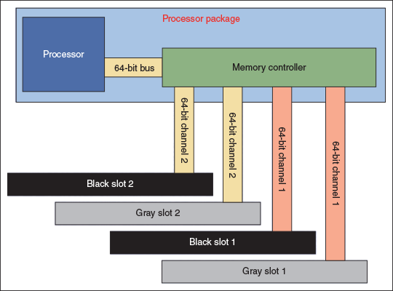
DIMM and SO-DIMM Technologies (5 of 15)
Figure 3-32 Using dual channels, the memory controller can read from two DIMMs at the same time

Slide 39
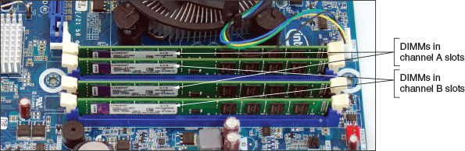
DIMM and SO-DIMM Technologies (6 of 15)
Figure 3-33 Matching pairs of DIMMs installed in four DIMM slots that support dual channeling

Slide 40
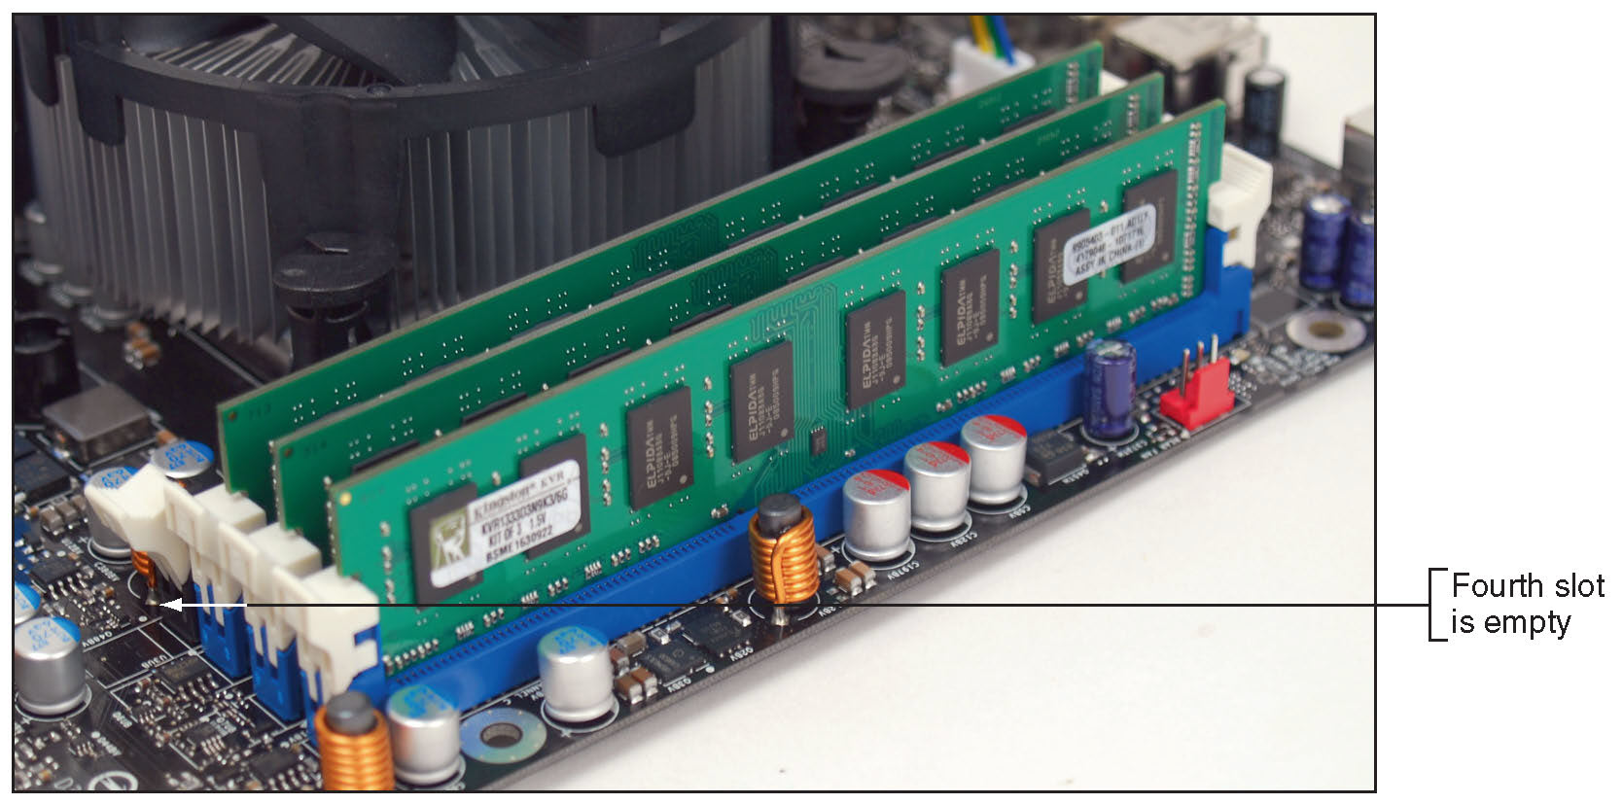
DIMM and SO-DIMM Technologies (7 of 15)
Figure 3-34 Three identical DDR3 DIMMs installed in a triple-channel configuration

Slide 41
DIMM and SO-DIMM Technologies (8 of 15)
Expect a motherboard that uses quad channeling to have eight memory slots
The eight DIMM slots support four channels; each channel has two slots
The processor can address four slots or four channels at the same time
To know which of the eight slots to populate for optimum performance, see the motherboard user manual

Slide 42
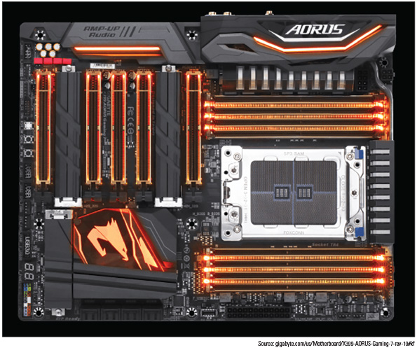
DIMM and SO-DIMM Technologies (9 of 15)
Figure 3-35 The Gigabyte AMD X399 Gaming motherboard has eight DIMM DDR4 slots and supports quad channeling

Slide 43
DIMM and SO-DIMM Technologies (10 of 15)
DIMM Speeds are measured in MHz and PC rating
PC rating is a measure of the total bandwidth of data moving between the module and the CPU
To calculate the PC rating for a DDR4 DIMM:
Multiply the speed by 8 bytes because a DIMM has an 8-byte or 64-bit data path
Example: a DDR4 DIMM that runs at 3,000 MHz has a bandwidth or transfer rate of 3,000 x 8 or 24,000 MB/second (expressed as a PC rating of PC4 24000
A DDR4 PC rating is labeled PC4

Slide 44
DIMM and SO-DIMM Technologies (11 of 15)
Error Checking and Parity
Error-correcting code (ECC):
Detects and corrects error in a single bit
Can detect errors in 2 bits but cannot correct it
Application: ECC makes 64-bit DIMM a 72-bit module
Parity – used by older SIMMs and uses error-checking based on an extra (ninth) bit
Odd parity
Parity bit set to make odd number of ones
Even parity
Parity bit set to make even number of ones
Parity error
Number of bits conflicts with parity used

Slide 45
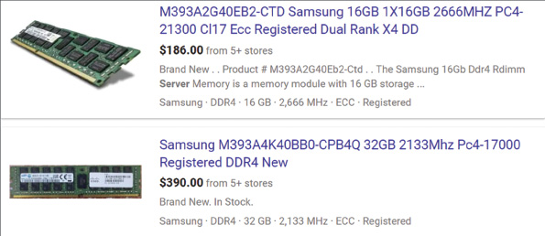
DIMM and SO-DIMM Technologies (12 of 15)
Figure 3-36 Server memory uses ECC for fault tolerance

Slide 46
DIMM and SO-DIMM Technologies (13 of 15)
Buffered and Registered DIMMS
Buffers and registers hold data and amplify a signal before data is written
Can increase memory performance in servers
Registered DIMM (RDIMM)
Uses registers
Unbuffered DIMM
No buffers or register support

Slide 47
DIMM and SO-DIMM Technologies (14 of 15)
CAS (column access strobe) Latency is a way of measuring access timing
Refers to number of clock cycles it takes to write or read a column or row of data off a memory module
Lower values are better than higher values
Memory module ads
Provide CAS latency value within series of timing numbers
Example: 5-5-5-15

Slide 48
DIMM and SO-DIMM Technologies (15 of 15)
Types of Memory Used in Laptops
Today’s laptops use DDR4, DDR3L, DDR3, or DDR2 SO-DIMM memory
Only use the type of memory the laptop is designed to support
The number of pins and the position of the notches on a SO-DIMM keep you from inserting the wrong module in a memory slot

Slide 49
How to Upgrade Memory (1 of 2)
To upgrade memory means to add more RAM to a computer
Adding more RAM might solve:
Slow performance
Applications refusing to load
An unstable system
Windows “Insufficient memory” error message

Slide 50
How to Upgrade Memory (2 of 2)
Questions to ask when adding more memory to your computer:
How much RAM do I need and how much is currently installed?
What type of memory is currently installed?
How many and what kind of modules can I fit on my motherboard?
How do I select and purchase the right modules for my upgrade?
How do I physically install the new modules?

Slide 51
How Much Memory Do I Need and How Much is Currently Installed?
When deciding how much memory the system can support:
Consider the limitations of the motherboard, processor, and operating system
Limitations when considering the OS:
Windows 10/8/7 require at least 1 GB for a 32-bit installation and 2 GB for a 64-bit installation
For 64-bit installations, Windows 10 Pro can support up to 2 TB of memory, Windows 8 Pro can support up to 512 GB, and Windows 7 Pro can support up to 192 GB
A 32-bit Windows 10/8/7 installation can support no more than 4 GB of memory

Slide 52
What Type of Memory is Already Installed? (1 of 3)
1. Open the case and look at memory slots
How many slots do you have?
How many are filled?
Review module imprint
2. Examine the motherboard for the imprinted manufacturer and model
3. Read motherboard documentation
See if the board supports dual, triple, or quad channels
4. If you still have not identified the module type:
Take the motherboard and old memory modules to a good computer parts store for confirmation

Slide 53
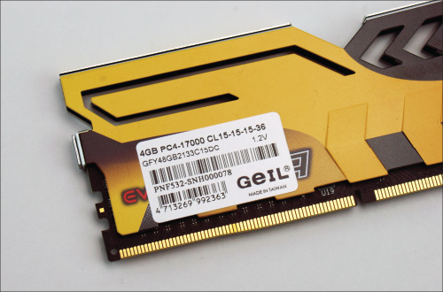
What Type of Memory is Already Installed? (2 of 3)
Figure 3-40 Use the label on this DIMM to identify its features

Slide 54
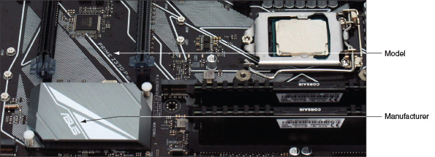
What Type of Memory is Already Installed? (3 of 3)
Figure 3-41 Look for the manufacturer and model of a motherboard imprinted somewhere on the board

Slide 55
How Many and What Kind of Modules Can Fit on my Motherboard? (1 of 3)
Read motherboard documentation
Indicates how much memory the motherboard can physically hold
DIMM modules
DIMMs can be installed as single modules
To support dual channeling:
Install matching DIMMs in each channel for best performance
Motherboard using DDR3 triple-channel DIMMs
Use three matching DIMMs in the three blue slots
If fourth slot populated, board reverts to single channeling
Dual channeling:
Install two matching DIMMs in two blue slots farthest from processor
Leave other two slots empty
For one installed DIMM:
Place it in the blue slot farthest position from processor

Slide 56
How Many and What Kind of Modules Can Fit on my Motherboard? (2 of 3)
Motherboard using DDR3 triple-channel DIMMs (continued)
Serial Presence Detect (SPD):
DIMM technology that declares module’s size, speed, voltage, and data path width to system BIOS at startup
Today’s memory always supports SPD

Slide 57
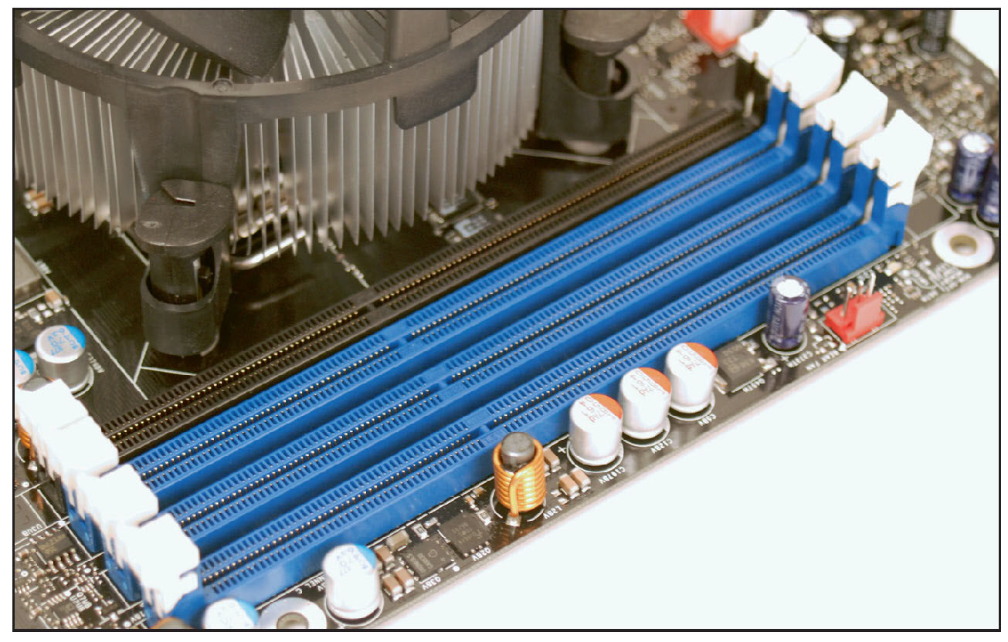
How Many and What Kind of Modules Can Fit on my Motherboard? (3 of 3)
Figure 3-43 Four DDR3 slots on a motherboard

Slide 58
How Do I Select and Purchase the Right Memory Modules? (1 of 2)
Compromises if the exact match is not available:
Mixing unbuffered memory with buffered or registered memory will not work
Match memory module manufacturer, if possible
In a pinch, try using memory from two different manufacturers
If mixing memory speeds:
All modules perform at slowest speed
Use a web site to research your purchase
Look for search utility matching modules to your motherboard

Slide 59
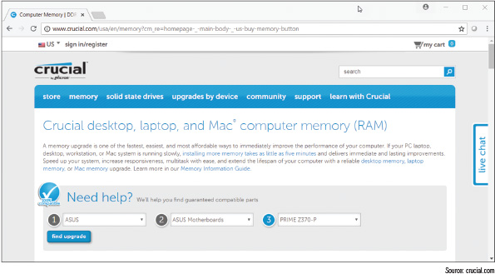
How Do I Select and Purchase the Right Memory Modules? (2 of 2)
Figure 3-44 Use the Crucial upgrade utility to find the correct memory for an upgrade

Slide 60
How Do I Install the New Modules? (1 of 4)
Follow these precautions:
Always use an ESD strap
Turn off power, unplug power cord, press power button, and remove case cover
Handle memory modules with care
Do not touch edge connectors on memory module or memory slot
Do not stack cards or modules
Look for notches on one side or in the middle for correct orientation

Slide 61
How Do I Install the New Modules? (2 of 4)
Install DIMMS:
Pull out supporting arms on the sides of the slot
Use notches on DIMM edge connector as a guide
Insert DIMM straight down into the slot
When the DIMM is fully inserted, the supporting clips pop back into place
When the computer powers up, it counts the memory present
You can enter BIOS/UEFI to verify that the memory is recognized

Slide 62
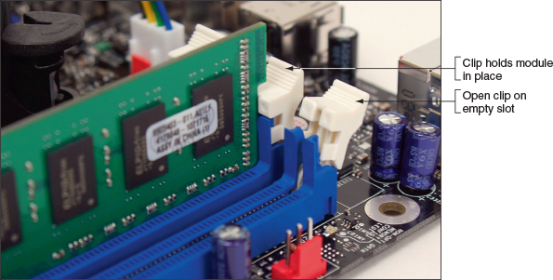
How Do I Install the New Modules? (3 of 4)
Figure 3-46 Clips on each side of a slot hold a DIMM in place

Slide 63
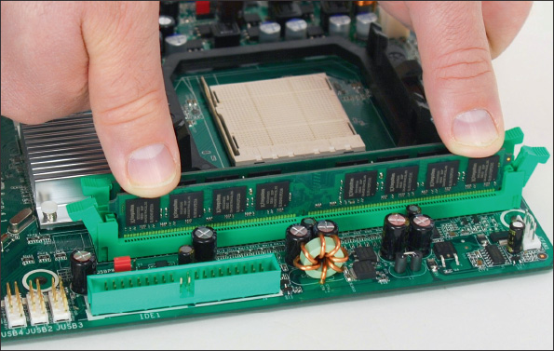
How Do I Install the New Modules? (4 of 4)
Figure 3-47 Insert the DIMM into the slot by pressing down until the support clips lock into position

Slide 64
How to Upgrade Memory on a Laptop
Upgrading memory on a laptop is similar to upgrading memory on a desktop
Considerations:
Make sure warranty is not being voided
Search for best buy on a suitable and authorized part
General steps:
Decide how much memory to upgrade
Purchase memory
Install it
Be sure to match the type of memory to the type the laptop supports

Slide 65
Chapter Summary (1 of 3)
The most important component on the motherboard is the processor, or CPU
Processors are rated by their processor speed, lithography, the socket and chipset they use, multiprocessing features, memory cache, memory features supported, virtualization, integrated graphics, overclocking, and processor architecture
The core of a processor has two arithmetic logic units (ALUs)
The current families of Intel processors for desktops include Core, Pentium, Atom, and Celeron
The current AMD desktop and laptop processor families are Ryzen, Ryzen Pro, Ryzen Threadripper, A-Series, A-Series Pro, and FX
Select a processor that the motherboard supports

Slide 66
Chapter Summary (2 of 3)
When installing a processor, always follow the directions in the motherboard user guide and be careful to protect the board and processor against ESD
Always apply thermal compound between the processor and cooler assembly to help draw heat from the processor
DRAM is stored on DIMMs for desktop computers and SO-DIMMs for laptops
Types of current DIMMs are DDR4, which have 288 pins, and DDR3 and DDR2 DIMMs, which have 240 pins
Matching DIMMs can work together in dual channels, triple channels, and quad channels so that the memory controller can access more than one DIMM at a time
DIMM speeds are measured in MHz or PC rating
The memory controller card can check memory for errors and possibly correct them using ECC

Slide 67
Chapter Summary (3 of 3)
Buffers and registers are used to hold data and amplify a data signal
CAS Latency (CL) measures access time to memory
Today’s laptops use DDR4, DDR3L, DDR3, or DDR2 SO-DIMMs
When upgrading memory, use the type, size, and speed the motherboard supports and match new modules to those already installed
When upgrading components on a laptop, including memory, use components that are the same brand as the laptop, or use only components recommended by the laptop’s manufacturer

